Slide 1





TRIP
Overview
TIME ANNUAL MEETING 2009

Slide 2

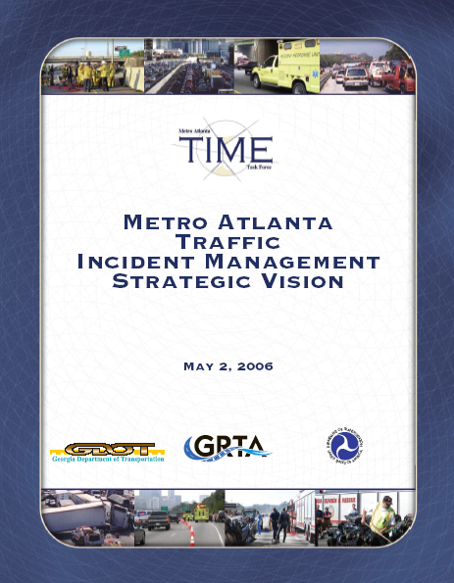
TRIP Overview
Georgia Towing and Recovery Incentive Program (TRIP)
TRIP is an initiative of the Traffic Incident Management Enhancement (TIME) Task Force Strategic Vision.
TRIP is a recovery incentive program to pay heavy-duty recovery companies a monetary bonus for clearing commercial vehicle wrecks quickly.
Similar program on Florida’s Turnpike

Slide 3
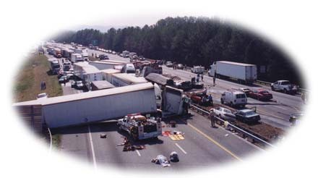
TRIP Overview: Purpose
Improve traffic incident management in the region
Facilitate quick and safe clearance of commercial vehicle crashes
Improve towing procedures. Program has trained over 180 Operators/Supervisors so far.
Improve scene safety
Making it more profitable for the towing community to meet quick clearance goals
Reduce the impact of major traffic
incidents while meeting clearance goals
Reduce secondary incidents

Slide 4
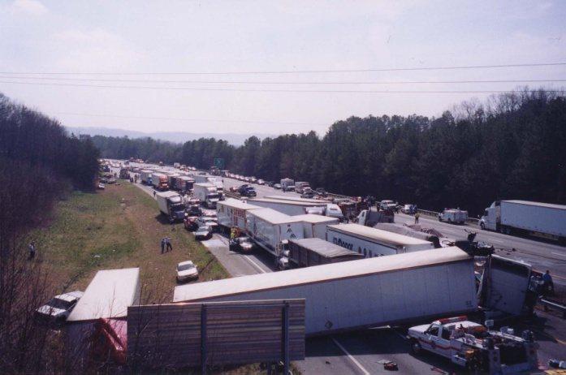
TRIP Specifications: Criteria
Program Criteria
  Truck Tractor Semi-Trailer Combo (Class 8)
  Trucks > 26,000 lbs (Class 7 or 8)
  Large Motor Homes & Motor Coaches (Class 5 or 6)
  Busses ≥ 16 passengers (Class 6, 7, or 8)
  Aircraft
Notes:
Review Criteria ONLY, Gary will ask for comments.

Slide 5
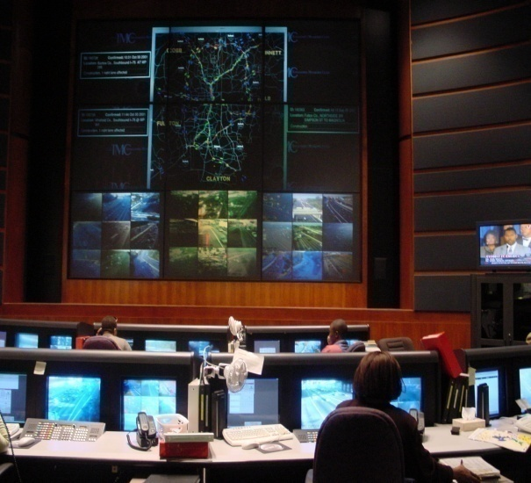
How is a TRIP Activated?
By GDOT HERO Supervisor with consensus of local police
The GDOT Traffic Management Center will notify the selected TRIP company when a major lane blocking crash occurs.
TRIP Companies respond quickly to the scene with two heavy-duty recovery wreckers and other support equipment.

Slide 6
TRIP Qualifications: Response Times
Supervisor:
30 minutes (5:30 am – 7:00 pm, Monday – Friday)
45 minutes (any other time than above)
Equipment (2 recovery trucks and support truck):
45 minutes (5:30 am – 7:00 pm, Monday – Friday)
60 minutes (any other time than above)
Notes:
All travel lanes must be open!

Slide 7
What are the requirements to participate in TRIP?
Prompt, predictable contractor response and 24/7 equipment
availability.
Minimum of one 30 ton and one 50 ton recovery wrecker with full sets of tools.
Support truck with an extensive array of equipment and full traffic control & fluid spill mitigation capability.
Other specialized heavy equipment (low-boys, bobcats, tractor-trailers)
Highly trained operators with full certification in advanced heavy towing and recovery as well as MUTCD traffic control and Hazardous Material awareness. also TIM ‘Quick Clearance’ strategies

Slide 8
TRIP Maintenance
After Incident Review (AIR) – every TRIP activation!
Periodic Inspections
Investigate complaints
On-going COMPANY training (8 hours annually)

Slide 9

What is the advantage of participating in TRIP?
Monetary compensation for meeting the following clearance goals:
  Response of both wreckers and support truck within a pre-determined timeframe.
  Clearing and opening all travel lanes successfully within 90 minutes from NTP
  Supplying additional special equipment at the request of incident commanders.
  $2500 to $3500 incentive for Quick Clearance
  (Truck owners pay all tow bills)
Note: Disincentive = $600 + $10 per minute after 3 hours

Slide 10
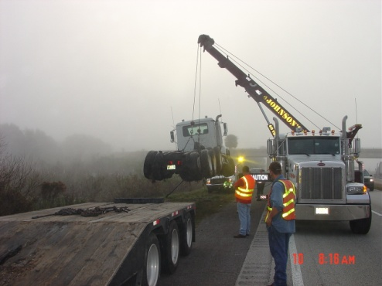
TRIP Overview: Performance Measures
Reduction in Response Times
Improvement in Roadway Clearance Times
Reduction in Travel Lane Blockage
Reduction in Secondary Incidents
Reduction in Incident Clearance Times
Dollar Saving from Reduced Congestion
Improved Air Quality

Slide 11
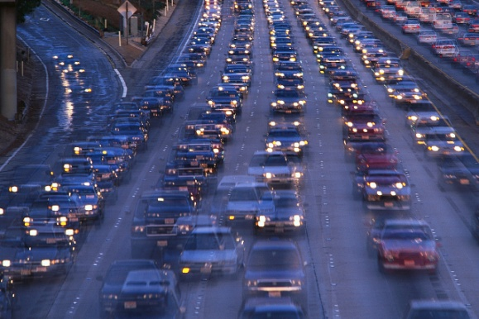
TRIP Overview: Benefits
Towing Industry: Safety & Monetary Incentives
Incident Responders: Improved roadway clearance times = SAFETY
Transportation Industry: Improve congestion,
get the roadways open quicker, make the public happy
Traveling Motorist: Less frustration and more
reliable travel times

Slide 12
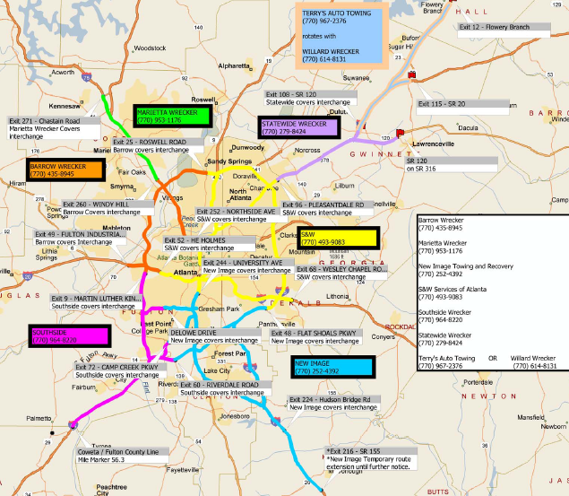

Slide 13
TRIP Project Boundaries & Expansion
Completed expansion up I-75
Expanded June 1, 2009
  I-85 North to Exit 115 (SR 20)
  I-985 North to Exit 12 (Flowery Branch)
Analyzing Crash Date to Determine Future Expansion Zones

Slide 14
TRIP Performance Measures
Comparison of Time to Roadway Clearance 2007 vs. 2008
.
-Note all activation, arrival, notice to proceed, and clearance times were rounded up to the nearest minute
Notes:
From 1/1/08-12/3/08: 54 TRIP incidents occurred of them 3 were disregarded due to inaccurate time keeping and 4 were disregarded because the incident was a roll out (a whole incident worth of data was not collected). This reduces the number of incidents to perform analysis on to 47 incidents. Of the 47 incidents only the incidents that landed within one standard deviation of the average would be taken into consideration for analysis to eliminate outliers that may skew the results. It was found that the average of the 47 incidents was 2:19:00 and the standard deviation was 2:01:00. With this the only incidents that have a Total Roadway Clearance Time within 0:18:00 – 4:20:00 shall be considered in the analysis. Of the 47 incidents 41 fall within the first standard deviation and therefore will be the incidents used in the analysis. The average time of incident for the 41 incidents within the first standard deviation was 1:46:31.
From 1/1/07-9/12/07: 27 Potential TRIP incidents occurred. Of the 27 incidents only the incidents that landed within one standard deviation of the average would be taken into consideration for analysis to eliminate outliers that may skew the results. It was found that the average of the 27 incidents was 4:58:00 and the standard deviation was 2:16:00. With this the only incidents that have a Total Roadway Clearance Time within 2:41:00 – 7:15:00 shall be considered in the analysis. Of the 27 incidents 21 fall within the first standard deviation and therefore will be the incidents used in the analysis. The average time of incident for the 21 incidents within the first standard deviation was 4:20:34.

Slide 15
TRIP Performance Measures
TRIP Activations
.
-Note 2007 numbers represent potential activations, 2009 numbers are up to September 2009
Notes:
From 1/1/08-12/3/08: 54 TRIP incidents occurred of them 3 were disregarded due to inaccurate time keeping and 4 were disregarded because the incident was a roll out (a whole incident worth of data was not collected). This reduces the number of incidents to perform analysis on to 47 incidents. Of the 47 incidents only the incidents that landed within one standard deviation of the average would be taken into consideration for analysis to eliminate outliers that may skew the results. It was found that the average of the 47 incidents was 2:19:00 and the standard deviation was 2:01:00. With this the only incidents that have a Total Roadway Clearance Time within 0:18:00 – 4:20:00 shall be considered in the analysis. Of the 47 incidents 41 fall within the first standard deviation and therefore will be the incidents used in the analysis. The average time of incident for the 41 incidents within the first standard deviation was 1:46:31.
From 1/1/07-9/12/07: 27 Potential TRIP incidents occurred. Of the 27 incidents only the incidents that landed within one standard deviation of the average would be taken into consideration for analysis to eliminate outliers that may skew the results. It was found that the average of the 27 incidents was 4:58:00 and the standard deviation was 2:16:00. With this the only incidents that have a Total Roadway Clearance Time within 2:41:00 – 7:15:00 shall be considered in the analysis. Of the 27 incidents 21 fall within the first standard deviation and therefore will be the incidents used in the analysis. The average time of incident for the 21 incidents within the first standard deviation was 4:20:34.

Slide 16
TRIP Program Costs and Benefits
Contract Management/Training $120-150K/year
Incentives Paid so far for 81 activations is over $214k.
Time Value Savings to traveling public are $360K per incident. (does not include fuel savings or secondary crash reduction)

Slide 17
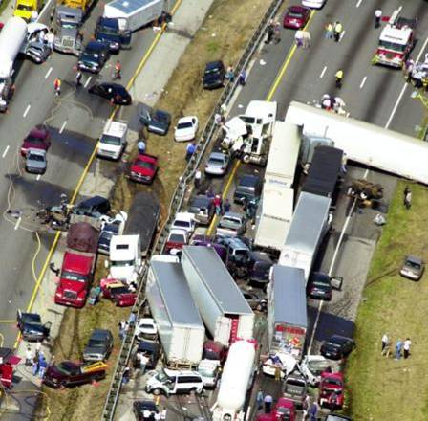
“The likelihood of a secondary crash increases by 2.8 percent for each minute the primary incident continues to be a hazard.”
Source: “ITS Impacts on Safety and Traffic Management” Karlaftis, Latoski, Richards, Sinha

Slide 18
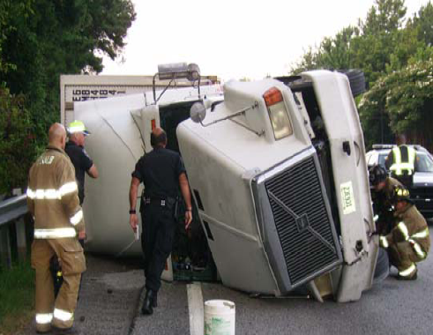
TRIP Program Costs and Benefits
A Independent Benefit Cost Analysis will be performed in 2010
Analysis will likely include cost savings for:
  Cost savings to motorist
  Cost savings for freight shipments
  Fuel savings
  Air quality / carbon emissions
  Secondary crash reduction

Slide 19
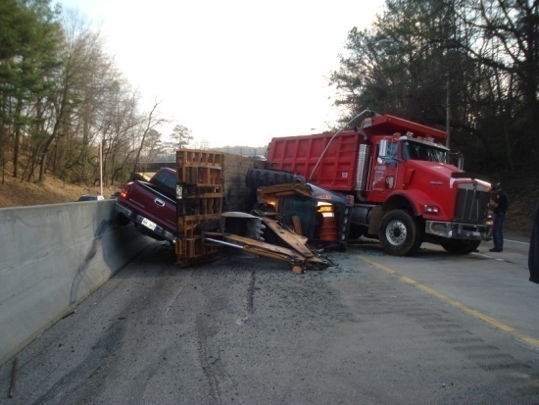
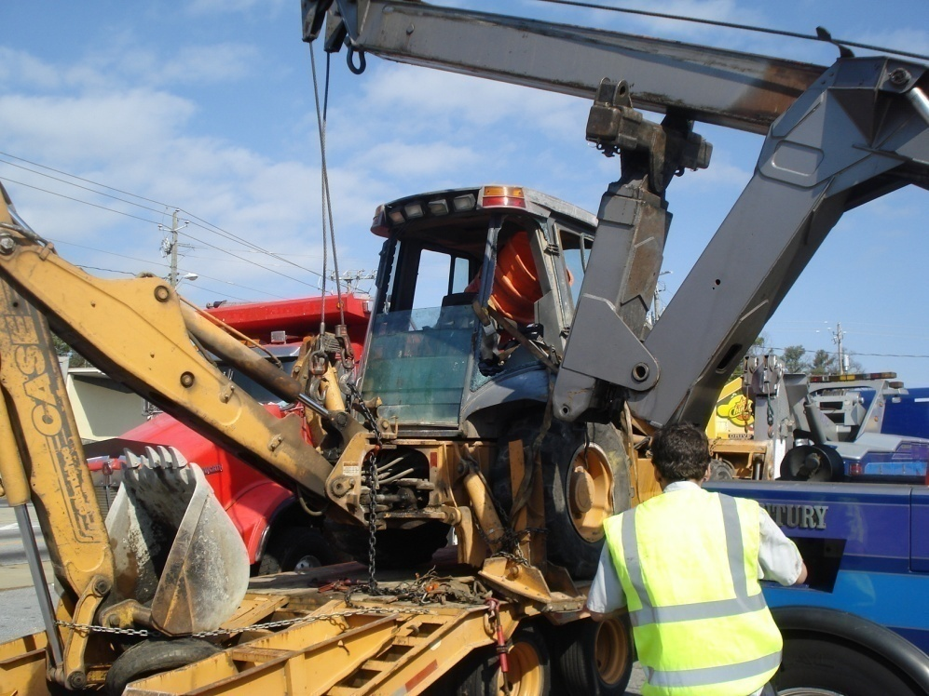
More Program Information
http://www.timetaskforce.com/trip.html
Applications
Maps
Pictures
Brochures
After Incident Review Summaries
Activation Criteria
Cheat Sheets for Police Agencies
Contact Cards

Slide 20
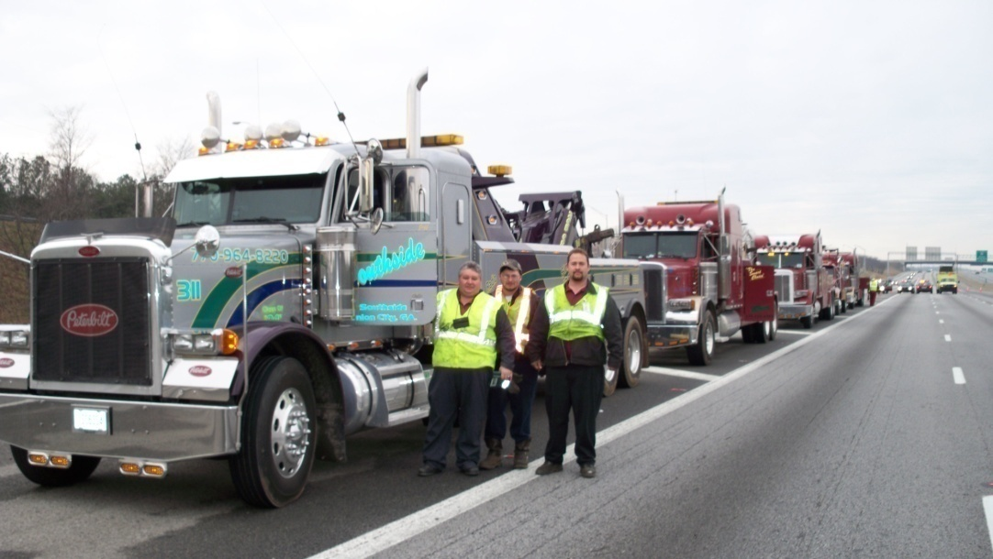
TRIP Contact Information
Gary Millsaps, GDOT/HERO
(404) 894-3857
gmillsaps@dot.ga.gov
Christine Simonton, Delcan
(404) 320-1776
c.simonton@delcan.com
Michael Roberson, GRTA
(404) 463-3014
mroberson@grta.org

Slide 21
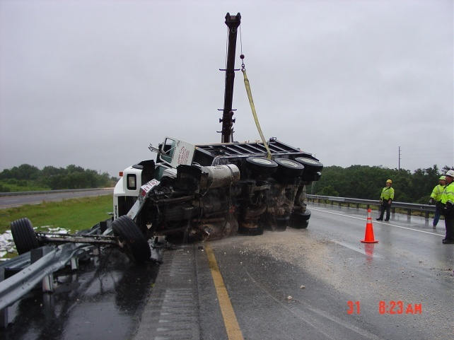
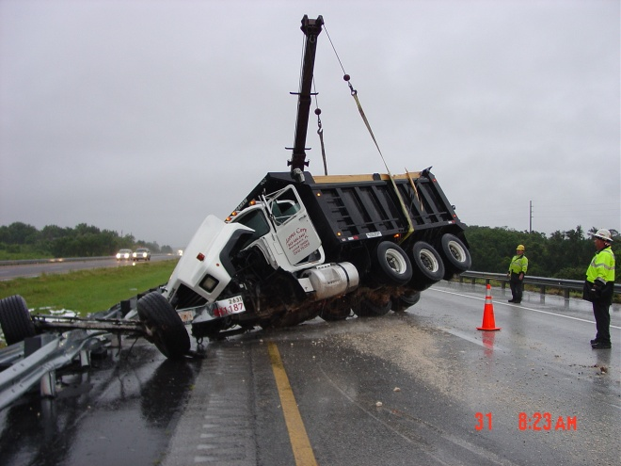
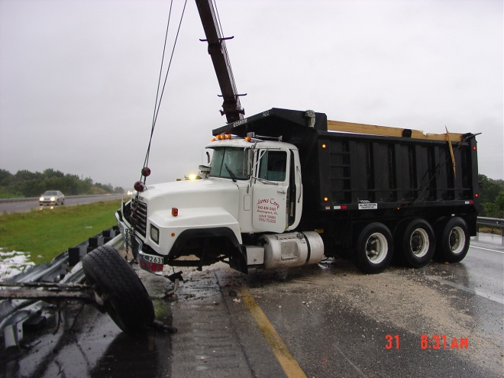
QUESTIONS?

