Slide 1
Highway Emergency Response Operator

Slide 2
HERO
A well trained technician whose primary responsibility is to expedite the clean up and removal of any congestion causing incident that occurs on the interstate system.

Slide 3
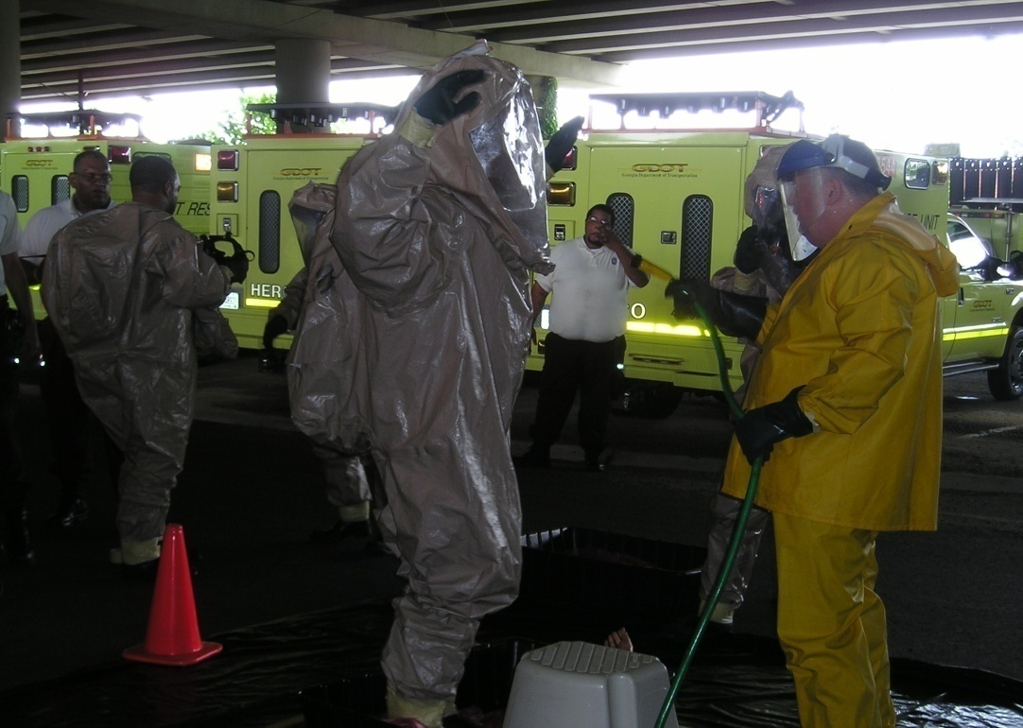
HERO TRAINING
300 hours of controlled environment training
Minimum of 5 weeks on-the-job training
Basic Auto Mechanics
Traffic Control & Incident Management
Emergency Vehicle Training
1st Responder Haz-Mat
Interagency Coordination
Crash Victim Extrication
Radio/Telephone Protocol
Legal Liability Issues
1st Responder First-Aid
Push Bumper Training

Slide 4
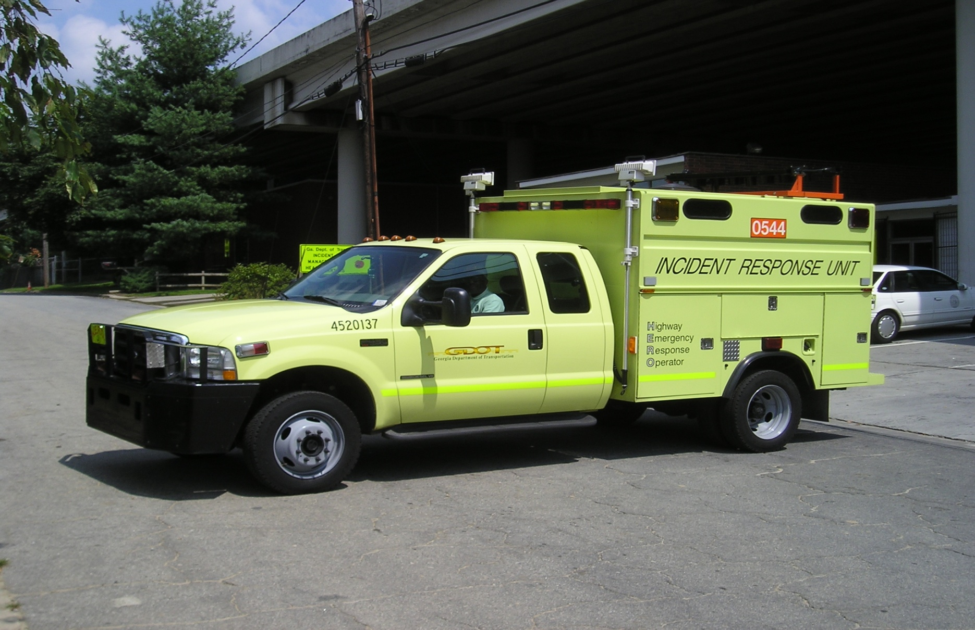
Highway Emergency Response Vehicle

Slide 5
HERO Vehicles are equipped with:
Push Bumpers
Traffic Control Devices
Fuel Transfer Tank
Retractable Arrow Board
Jump Starting System
Halogen Flood Lights
First Aid Kits
Air Compressor
Air Tools
P.A. System
Power Inverter
Floor Jack
Hand Tools
Absorbent Materials
Gasoline, Coolant
Nextel Radios&
800MHz Radios

Slide 6
Types of Assistance
Providing small quantities of fuel
Changing flat tires
Jump starting vehicles
Minor mechanical repairs
Providing coolant/water
Relocating stalled vehicles (from hazardous locations)
Transport stranded motorists
Provide road and travel information

Slide 7
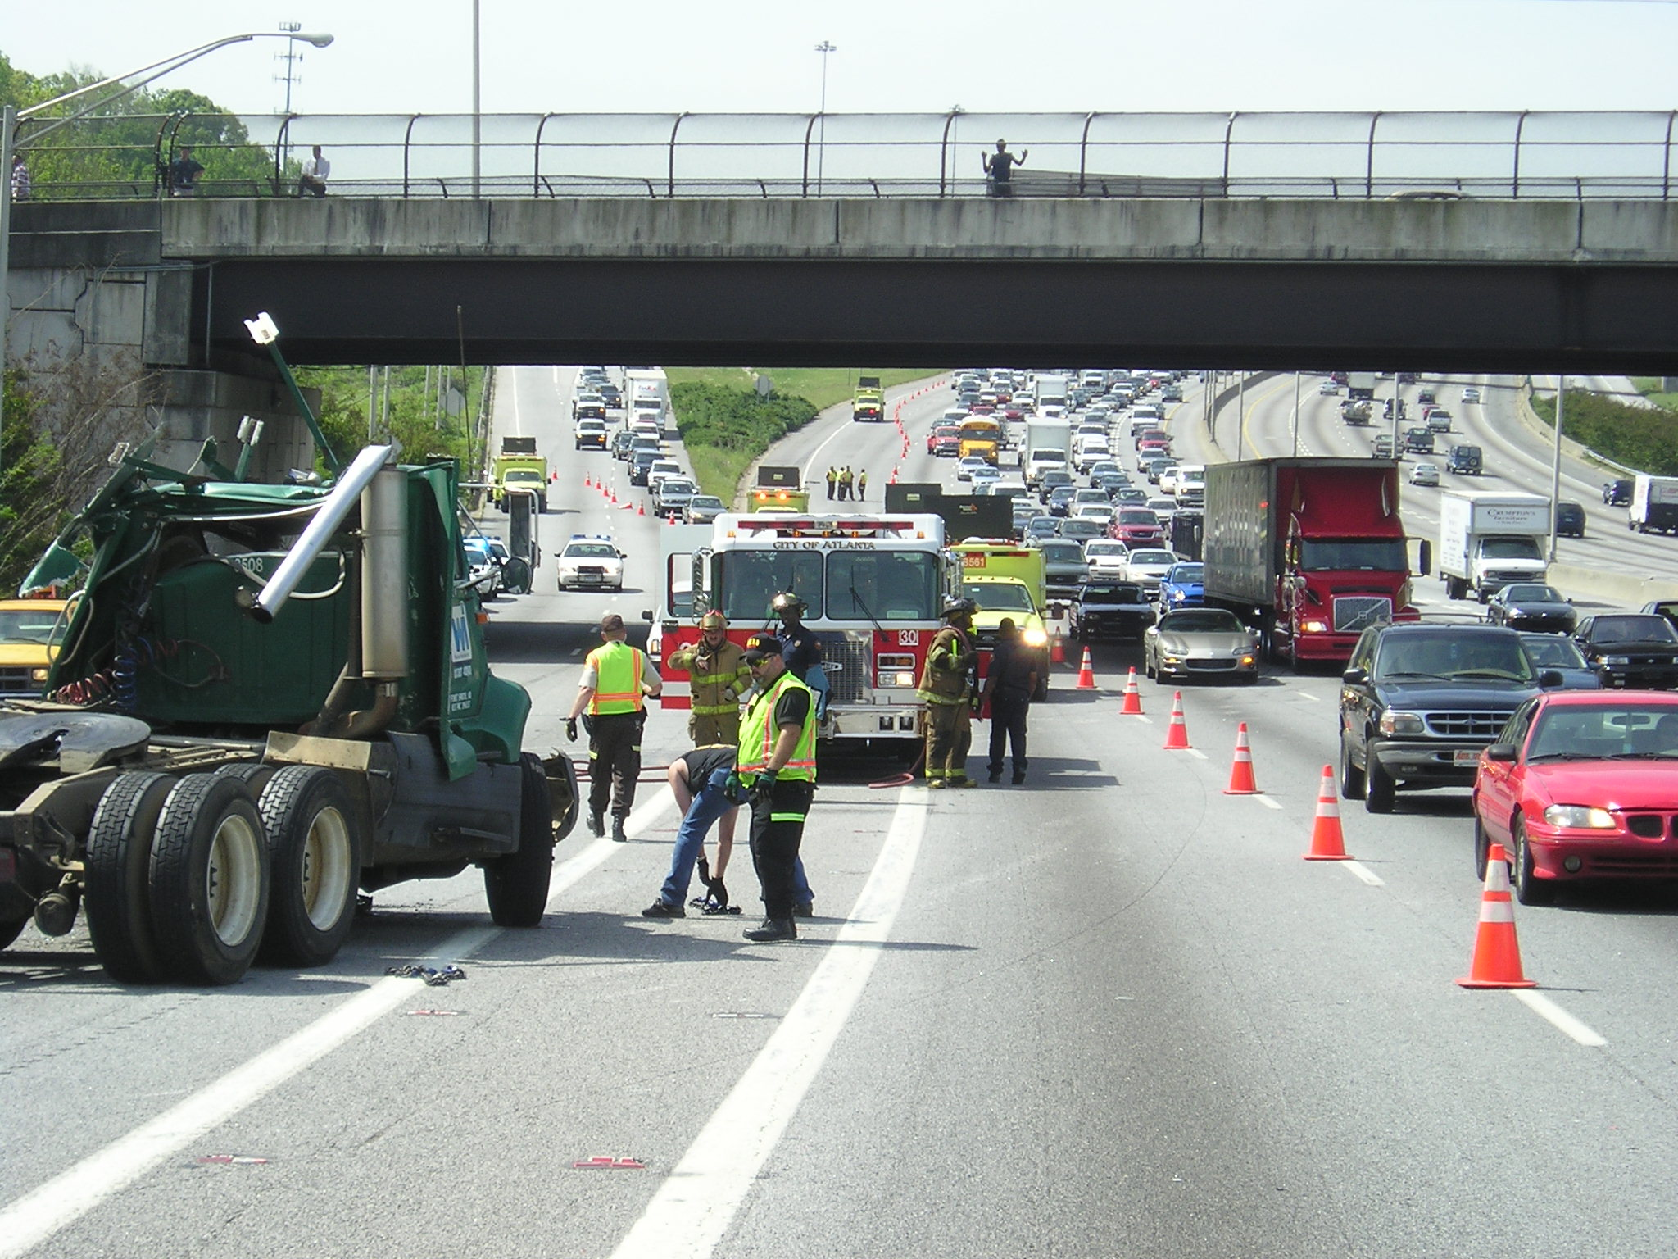
Setting up traffic control and/or detour routes at major incident scenes

Slide 8
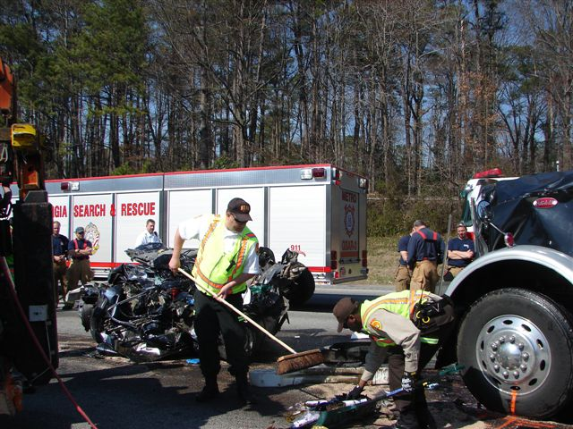
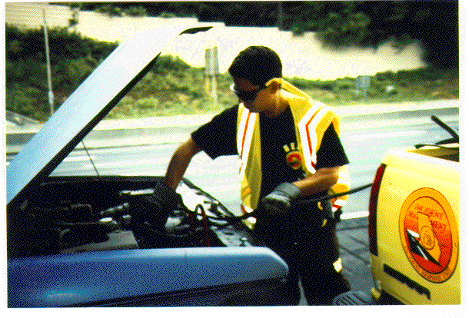
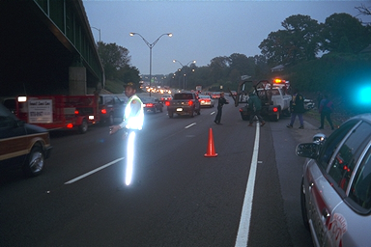
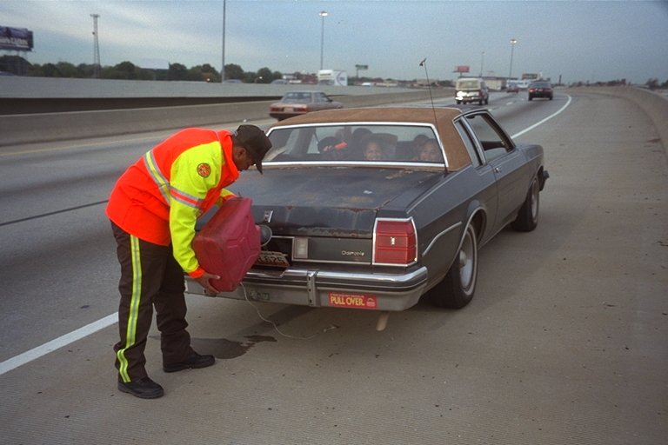
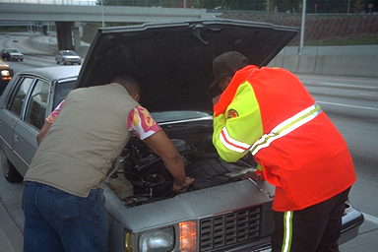
HERO Unit

Slide 10
Total Assists for 2008
96,437

Slide 11
I-575
Other
Ga 400
I-75/85
I-20
I-75
I-85
I-285
32
181
535
1029
1167
1424
1606
2708

Slide 12
Type Incidents & Detection

Slide 13
QUESTIONS?
GARY MILLSAPS
GEORGIA DOT – HERO Manager
gmillsaps@dot.ga.gov
(404) 894-3857

